Slide 1
Bank Management System
Presented by:-
Prasanna.G
Batch Code:-2021-6139

Slide 2
Introduction
The Bank Management System is an application for maintaining a person’s account in a bank.
The System provide the access to the customer to create a bank account like a deposit of amount, withdrawal of amount, etc.
The following presentation provides the specification for the Application.

Slide 3
Module
Main menu:
Display all account details.
Search by account number.
Deposit the amount.
Withdraw the amount.
Exit.

Slide 4
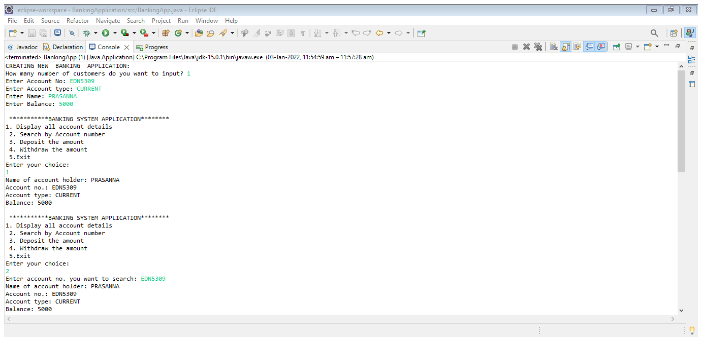
OUTPUT

Slide 5
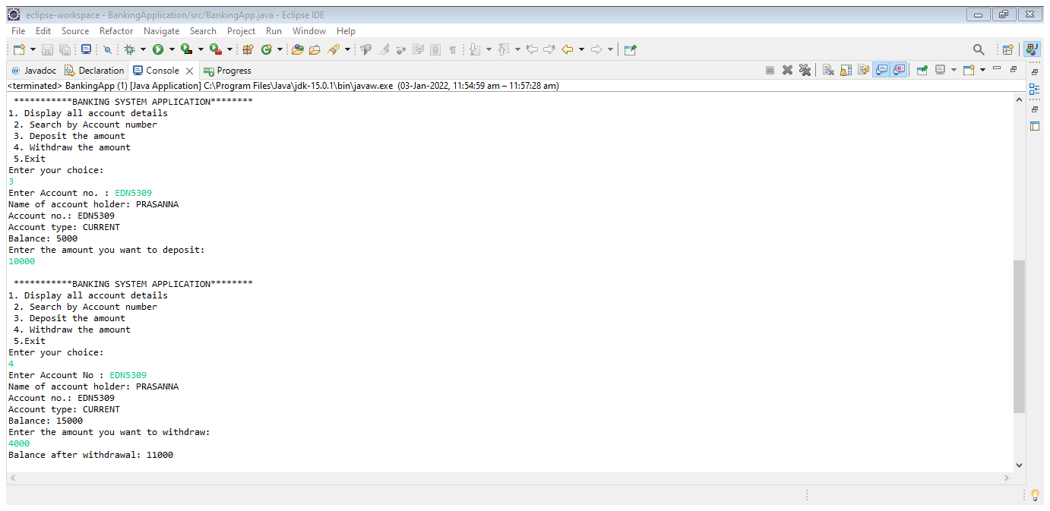

Slide 6
THANK YOU

